Slide 1
Machine learning

Slide 2
Topics of Seminar
Introduction to Machine Learning
Difference between traditional programming and machine learning
Types of Machine Learning
Agorithms
Applications

Slide 3
Machine Learning
Machine Learning is a subfield of AI (artificial intelligence).
Machine Learning train models from the input data and gives us prediction.
This Prediction helps us to make future decision.
It enables computers to make decisions, recognize patterns, and provide insights from vast amounts of data.
5. ML is the backbone of many modern technologies, from recommendation systems to autonomous vehicles and natural language processing.

Slide 4
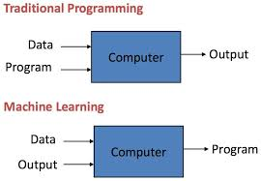
Difference :

Slide 5
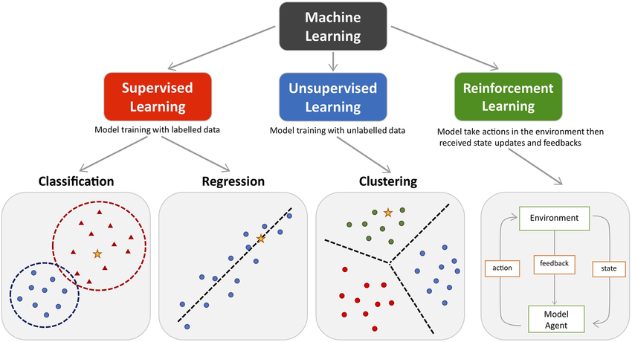
Types of Machine Learning

Slide 6
Supervised Learning:
Uses labeled data to train models.
The model learns to predict outcomes based on input-output pairs.
Examples: Linear Regression, Decision Trees, Support Vector Machines.
Unsupervised Learning:
Uses unlabeled data to discover patterns or groupings.
The model explores the data structure on its own.
Examples: K-Means Clustering, Principal Component Analysis (PCA).

Slide 7
Reinforcement Learning:
The model learns by interacting with an environment and receiving feedback in the form of rewards or penalties.
Commonly used in robotics, gaming, and navigation.
Examples: Q-Learning, Deep Q Networks (DQN).

Slide 8
Algorithms
Supervised Learning Algorithms:
Regression Algorithms: Used for predicting continuous values. Example: Linear Regression.
Classification Algorithms: Used to assign categories to inputs. Example: Logistic Regression, Decision Trees.
Ensemble Methods: Combine multiple models to improve performance. Example: Random Forest, Gradient Boosting.
Unsupervised Learning Algorithms:
Clustering Algorithms: Group similar data points without labels. Example: K-Means, DBSCAN.
Dimensionality Reduction: Simplifies data by reducing features.
Example: PCA

Slide 9
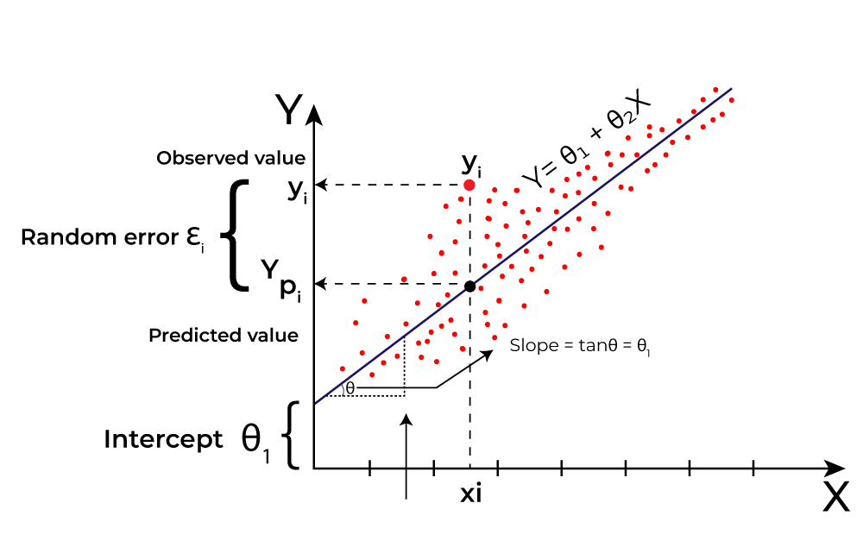
Commonly Used Algorithms in Machine Learning:
1. Linear Regression (Supervised - Regression)
Purpose: Predicts continuous numerical values.
How it works: Fits a straight line through the data points to minimize the difference between predicted and actual values.
Use Case: Predicting housing prices, stock trends.

Slide 10
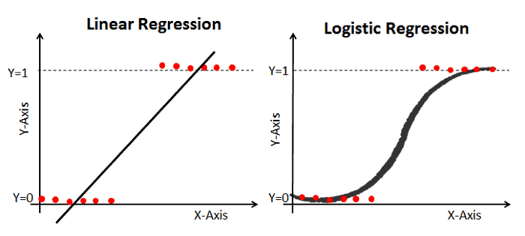
2. Logistic Regression (Supervised - Classification)
Purpose: Used for binary or multi-class classification tasks.
How it works: Estimates the probability of a data point belonging to a class using a logistic (sigmoid) function.
Use Case: Email spam detection, disease prediction.

Slide 11
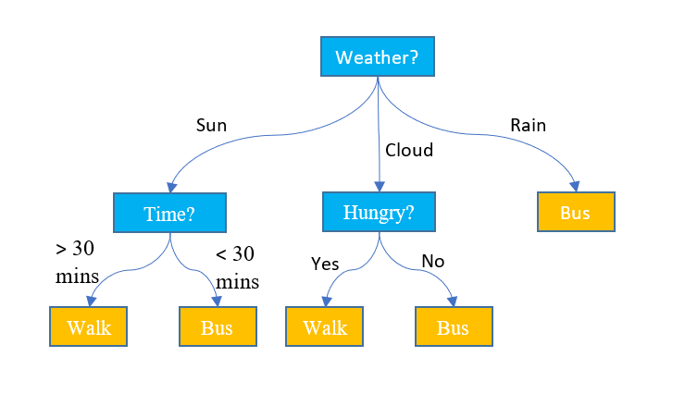
3. Decision Trees (Supervised - Classification & Regression)
Purpose: Splits the dataset into subsets based on feature values.
How it works: Builds a tree structure where each node represents a feature and branches represent decision rules.
Use Case: Loan approval.

Slide 12
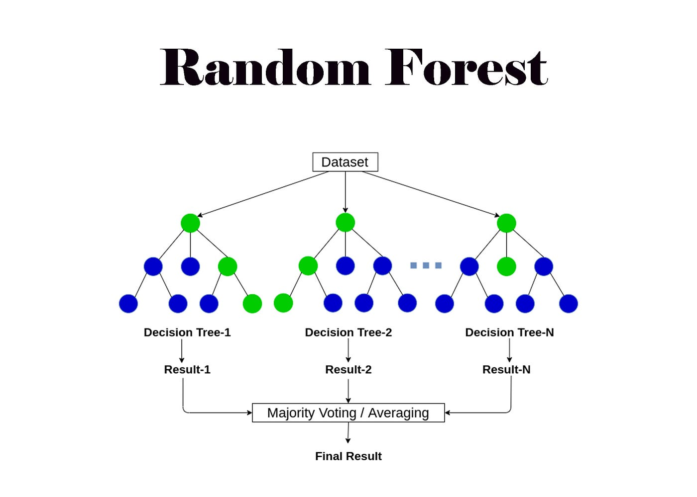
4. Random Forest (Supervised - Ensemble)
Purpose: Improves accuracy by combining multiple decision trees.
How it works: Trains multiple decision trees on random subsets and averages their predictions.
Use Case: Fraud detection, credit scoring.

Slide 13
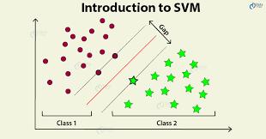
5. Support Vector Machine (SVM) (Supervised - Classification)
Purpose: Separates classes with a clear boundary (margin).
How it works: Finds the optimal hyperplane that separates data into classes.
Use Case: text categorization.

Slide 14
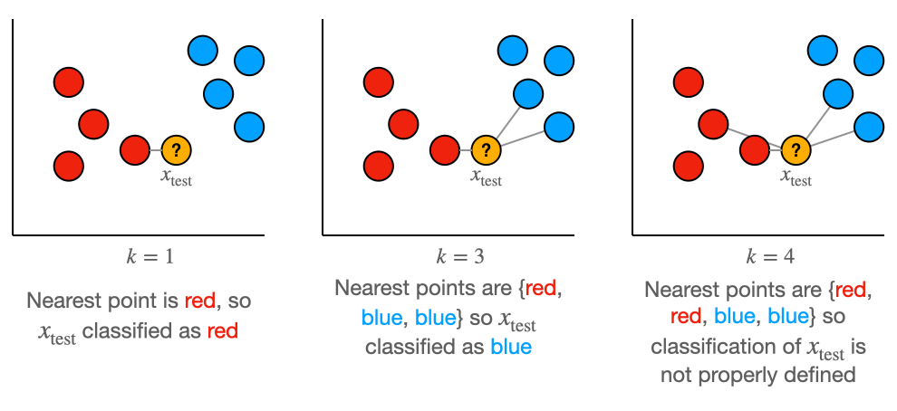
6. K-Nearest Neighbors (KNN) (Supervised - Classification & Regression)
Purpose: Classifies data based on the majority label among the 'k' nearest neighbors.
How it works: Measures distance between new input and existing data points.
Use Case: Handwriting recognition, recommendation systems.

